Slide 1

Controlling Player Avatars and Influencing Game Worlds Using Multi-Modal Input Systems

Slide 2
What does this mean!!!
My project aims to take in multiple forms of bio and physiological feedback and translate them into forms of input for a video game.
I would like to explore the act of using these inputs as ways to control humanoid virtual avatars and abstract events within the game.
Examples:
Controlling bone rig of avatar.
Movement of objects in space
Pulling and pushing global vector fields.
Magic systems.

Slide 3
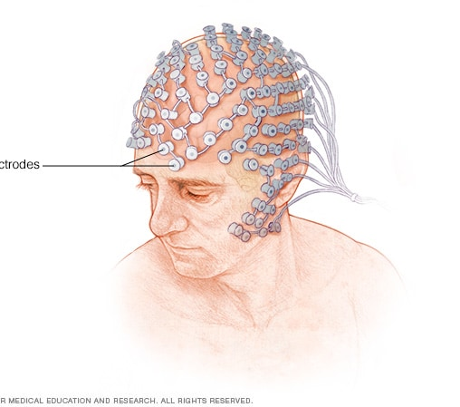
What is Electroencephalography (EEG)

Slide 4

What is Electromyography (EEG)

Slide 5
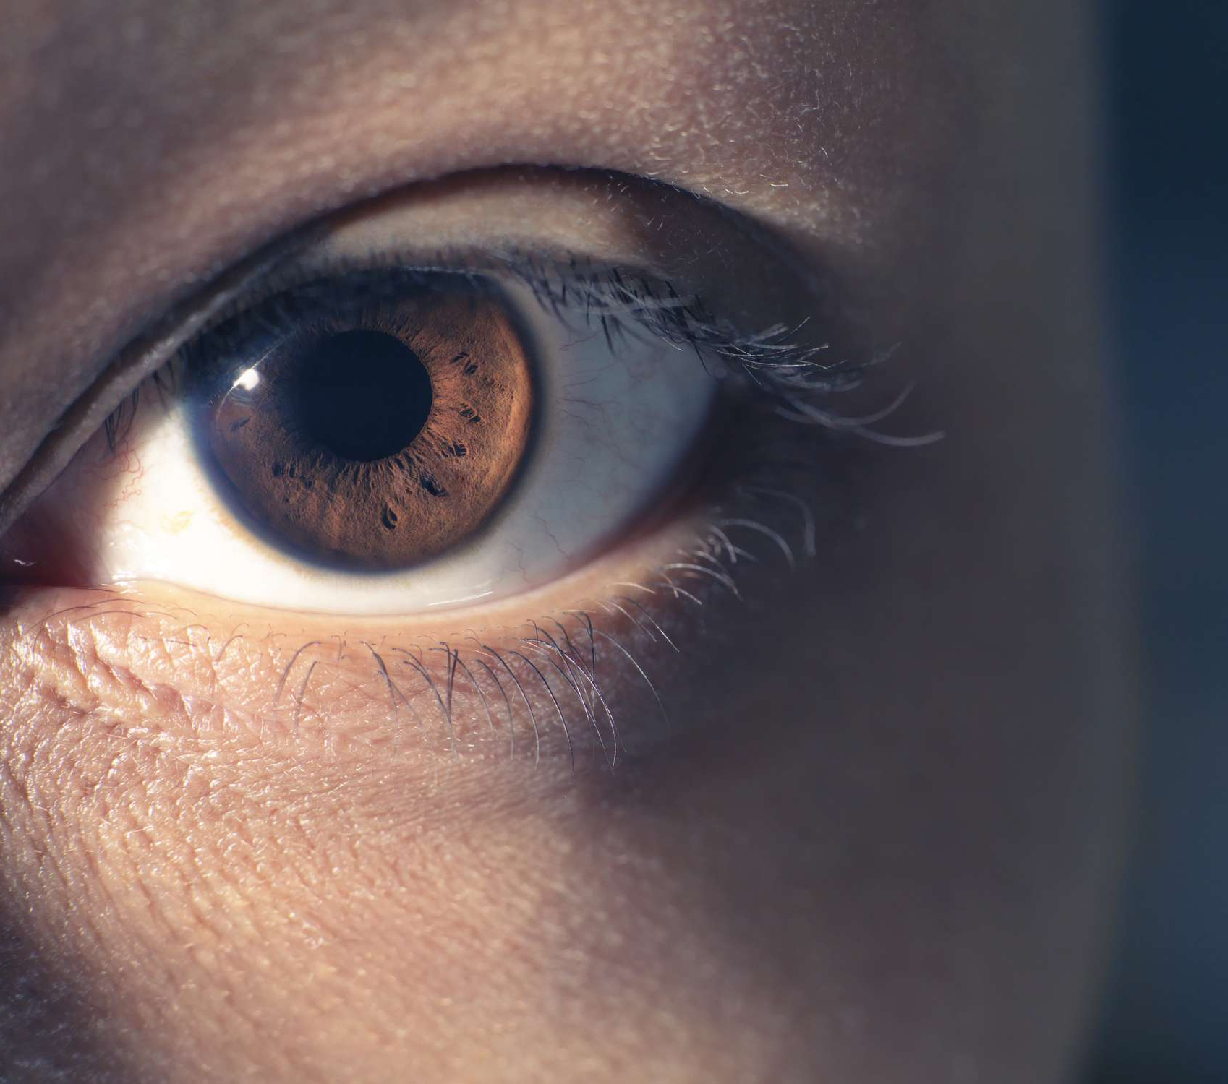
What is eye-tracking

Slide 6
Why combine these methods?
Each method can give rise to different methods interaction.
When combined each method can give context to expand upon the others.

Slide 7
Similar works
Prosthetics
Focus based EEG games

